Slide 1
Spiking Neural Networks for Scientific Machine Learning
Qian Zhang
Brown University

Slide 2
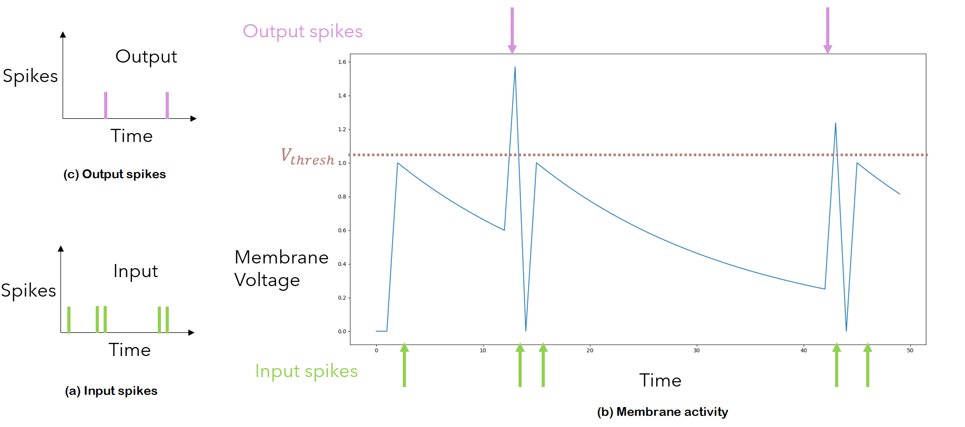
Key Challenge: Discontinuity
Example of the membrane voltage over time with five input spikes. The reset mechanism is set to resting position without refraction. (a) Presents the input spikes over time. (b) Presents the membrane activity. Notice that when the membrane voltage exceeds the threshold, an output spike is registered and the membrane resets.

Slide 3
Overview
Approach 1: Train with ANN, infer with SNN
ANN-SNN Conversion with calibration (Yuhang, Yale)
Applications to PINN (including high-dimensional problems) and DeepONet
Implementation on neuromorphic hardware (Brad, Sandia)
Approach 2: Train with SNN, infer with SNN
End-to-end spiking training
Randomized Forward-mode Gradient Estimation (Ruyin, Brown)
Notes:
However, the performance improvement of NN in not a free lunch.

Slide 4
ANN-SNN Conversion: Overview
A natural idea of conversion is simply keep the architecture and trainable parameters, and replace all continuous activation functions with spiking mechanisms.

Slide 5
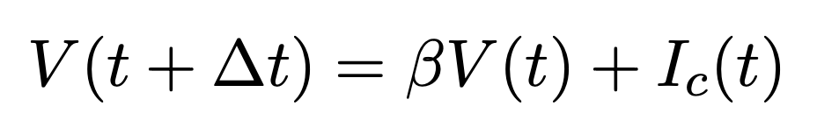
ANN-SNN Conversion: Spiking Mechanism
This leads to the following challenges:
Find the proper spiking mechanism for each activation function.
Maintain the accuracy.
For ReLU activation functions, the spiking mechanism is the IF model without reset. The membrane potential evolves according to

Slide 6
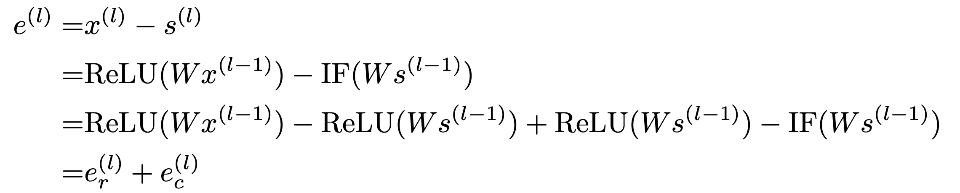
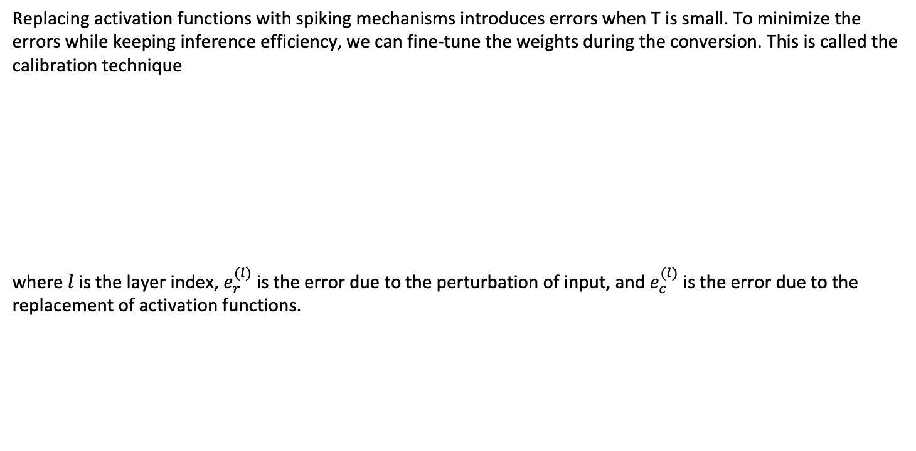
ANN-SNN Conversion: Error and Calibration
Replacing activation functions with spiking mechanisms introduces errors when T is small. To minimize the errors while keeping inference efficiency, we can fine-tune the weights during the conversion. This is called the calibration technique
where $l$ is the layer index, $e_{r}^{(l)}$ is the error due to the perturbation of input, and $e_{c}^{(l)}$ is the error due to the replacement of activation functions.

Slide 7
ANN-SNN Conversion: Calibration
The blue arrows represent the calibration tuning process.
Notes:
However, most studies on spiking neural network are limited to shallow network architectures on simple datasets like MNIST.
One of the key reason is a difficulty in training spiking neural network.

Slide 8
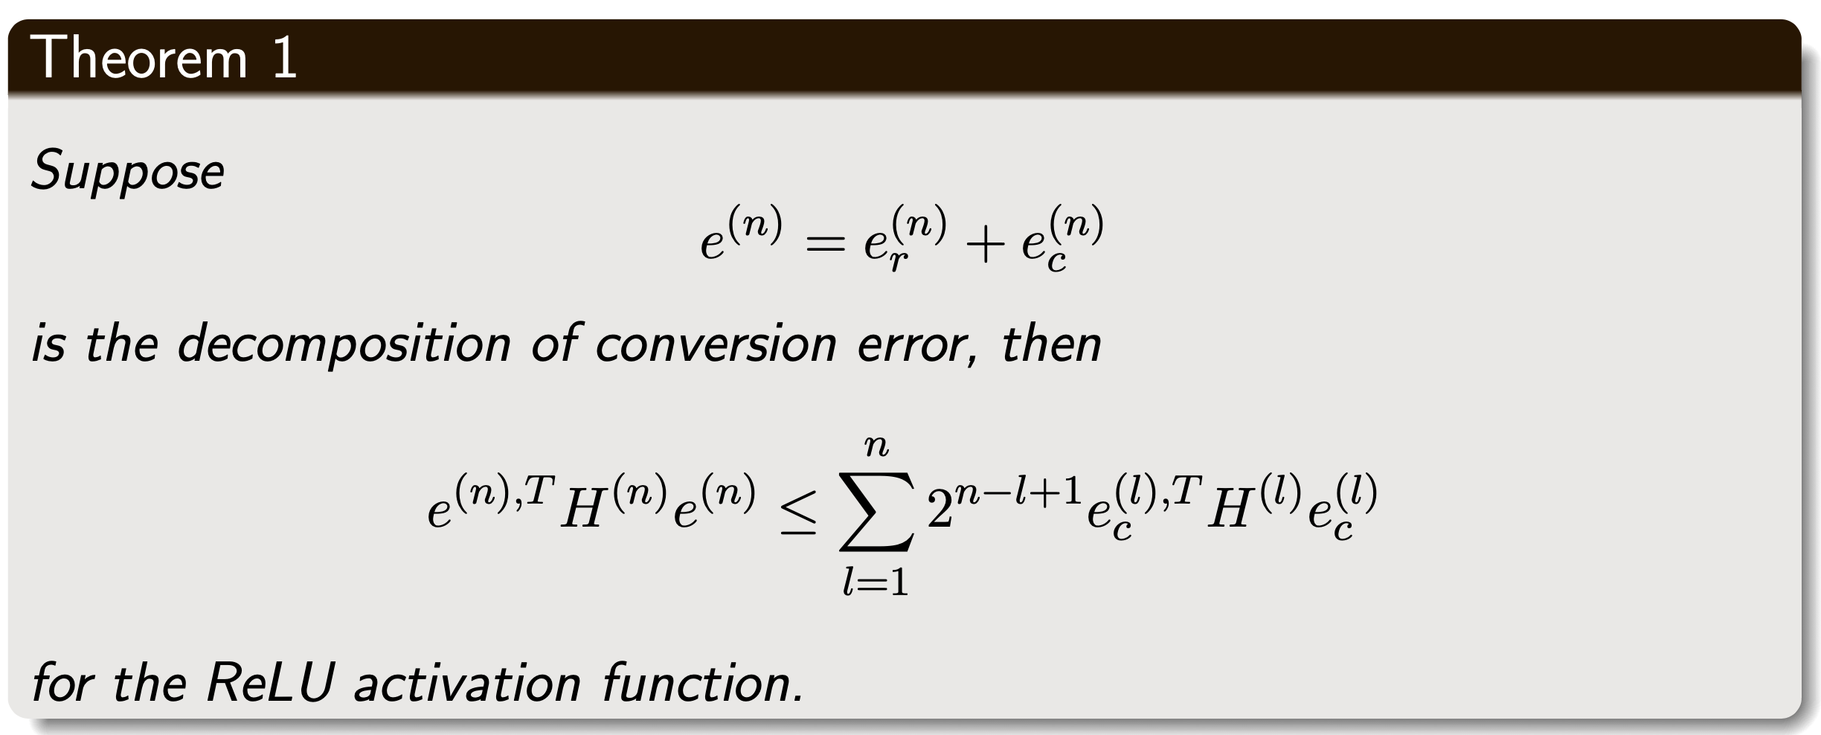
ANN-SNN Conversion: Calibration Theorem for ReLU
The theorem guarantees the calibration reduces the conversion error. each layer l. The key idea of proof is to use ReLU’s property that it does not contain high-order derivatives.
Li, Y., Deng, S., Dong, X., Gong, R., & Gu, S. (2021). A free lunch from ANN: Towards efficient, accurate spiking neural networks calibration. Proceedings of the 38th International Conference on Machine Learning, Proceedings of Machine Learning Research, 139, 6316–6325.

Slide 9
ANN-SNN Conversion: Handling Non-ReLU Activation Functions
We need to consider activation functions like tanh for PINNs. The conversion of tanh is more challenging because of the following two difficulties:
tanh can output negative values, which is not in the framework of standard spiking neurons.
tanh contains high-order derivatives, and this may lead to undesired error accumulation in calibration.
We found that these difficulties can be solved by:
Introducing negative spikes to handle negative values. Each neuron stores both positive and negative membrane potential and process them separately.
Approximating the activation function with piecewise linear functions, we can find the extra error accumulation in calibration can be bounded well.

Slide 10
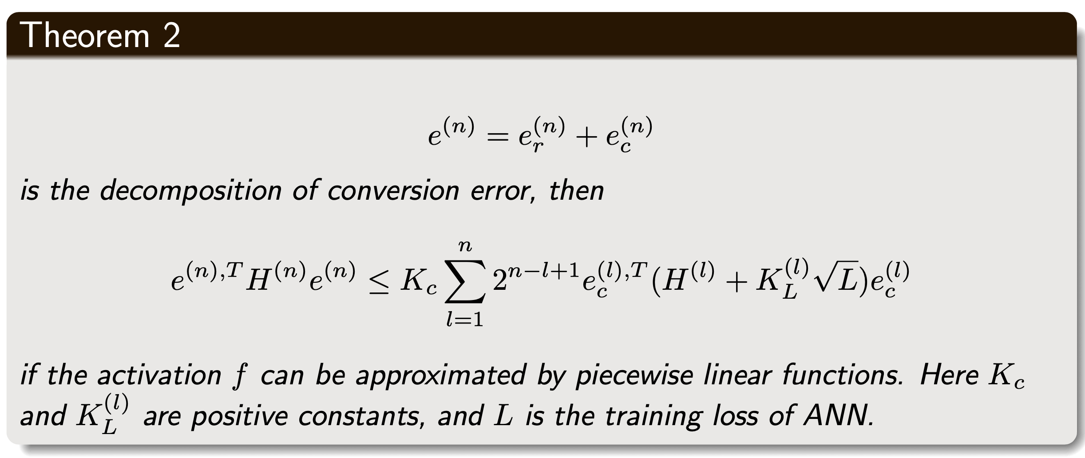
ANN-SNN Conversion: General Calibration Theorem
Zhang, Q., Wu, C., Kahana, A., Kim, Y., Li, Y., Karniadakis, G. E., & Panda, P. (2023). Artificial to spiking neural networks conversion for scientific machine learning. arXiv. https://arxiv.org/abs/2308.16372
Extreme resource constraint edge device (<1MB, <1W)

Slide 11
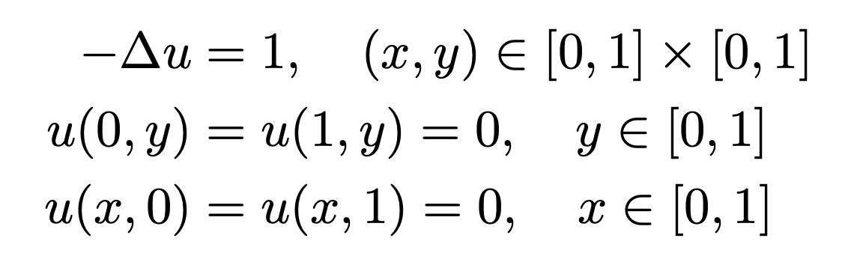
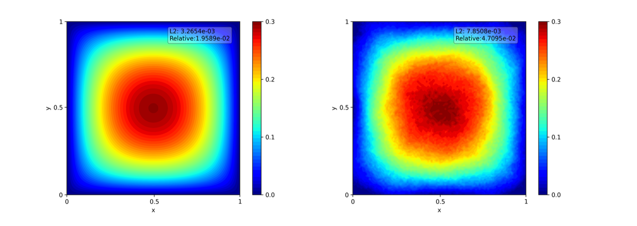
ANN-SNN Conversion: Results
We train a PINN to solve the 2d Poisson equation:
and here are the results from the original PINN and the converted SNN. We use T = 64.
Solution of Poisson equation with PINN (ANN, left) and converted SNN (right).

Slide 12
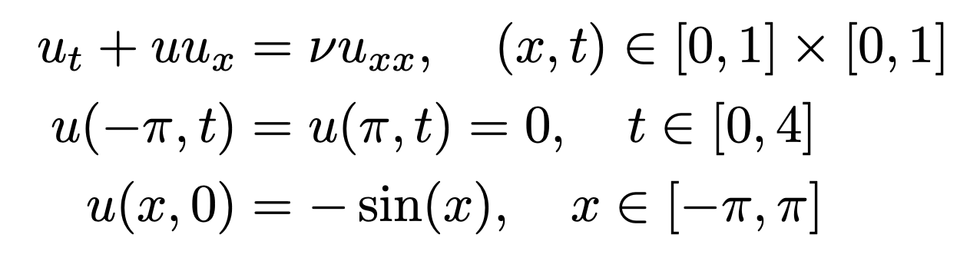
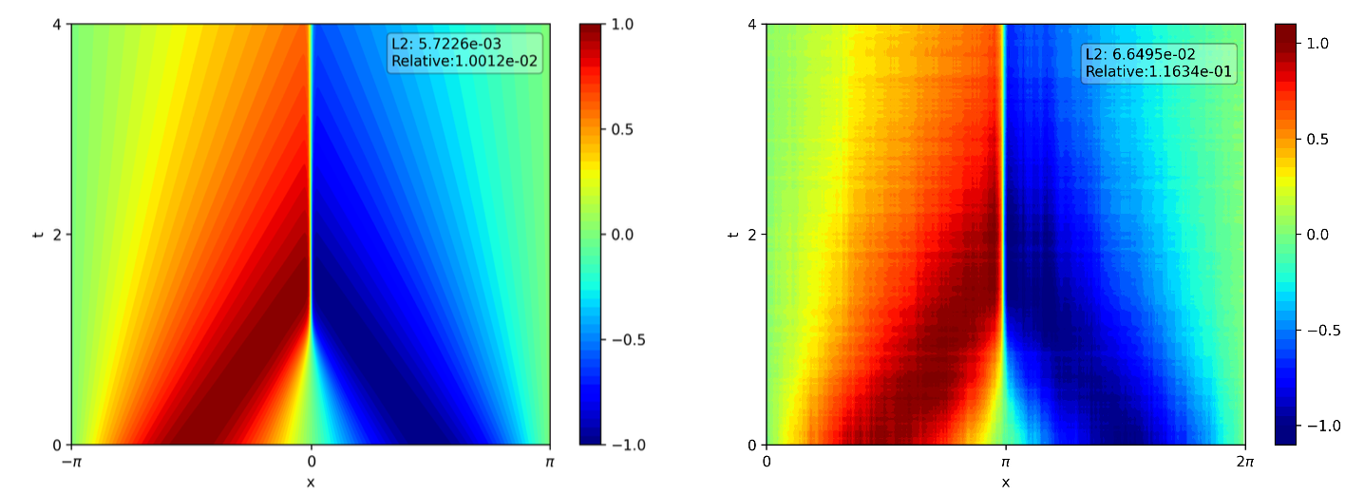
ANN-SNN Conversion: Results
We train a PINN to solve the Burgers equation:
where ν = 0.01. Here are the results from the original Separable PINN and the converted SNN. We use T = 128.
Solution of Burgers equation with PINN (ANN, left) and converted SNN (right).

Slide 13
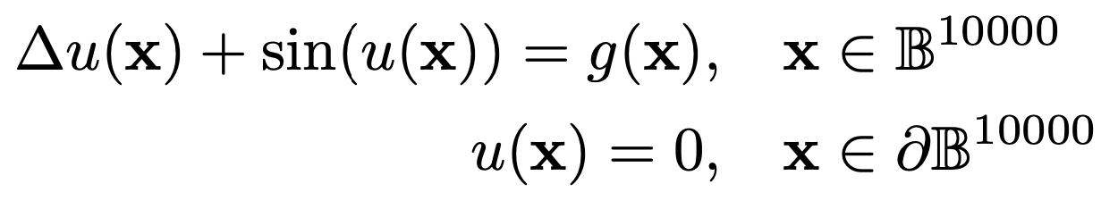
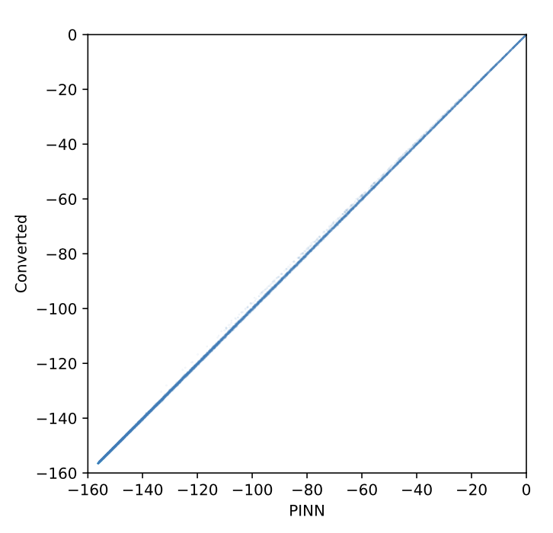
ANN-SNN Conversion: Results
We train a PINN to solve the 10,000-dim Sine-Gordon equation:
and here are the results from PINN (ANN) and converted SNN. We use T = 64.
Scatter plot of the 10,000-dim Sine-Gordon equation solutions. The x-axis represents PINN (ANN) solution and the y-axis represents the converted SNN solution.

Slide 14
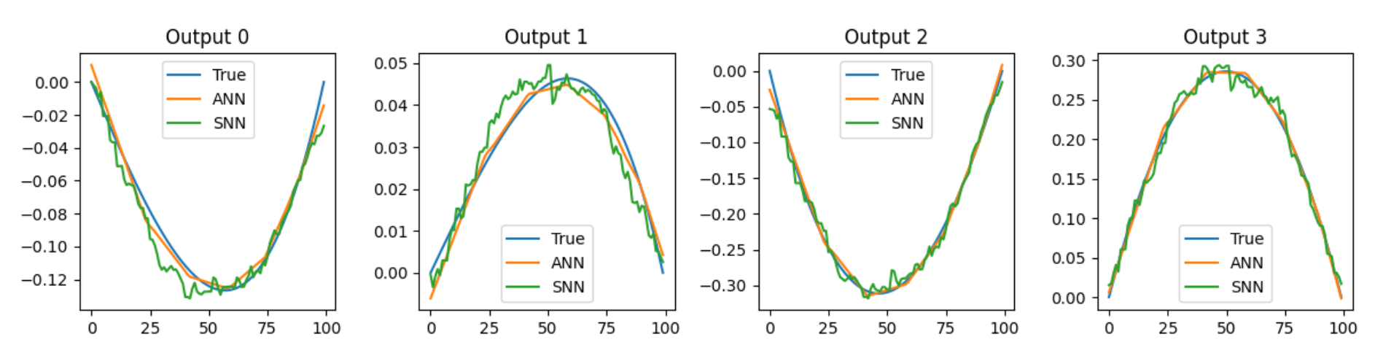
ANN-SNN Conversion: DeepONet
We can further convert the DeepONet by the following two-step procedure:
Converting the branch and trunk network separately
Surrogate training on the whole network to finetune the weights.
Here are the results of the spiking DeepONet by floating point simulation.
Results of the spiking DeepONet solving 1D Poisson equation.

Slide 15
Overview
Approach 1: Train with ANN, infer with SNN
ANN-SNN Conversion with calibration (Yuhang, Yale)
Applications to PINN (including high-dimensional problems) and DeepONet
Implementation on neuromorphic hardware (Brad, Sandia)
Approach 2: Train with SNN, infer with SNN
End-to-end spiking training
Randomized Forward-mode Gradient Estimation (Ruyin, Brown)
Notes:
However, the performance improvement of NN in not a free lunch.

Slide 16
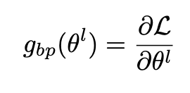
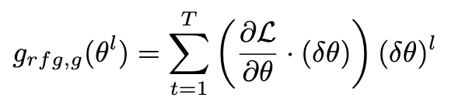
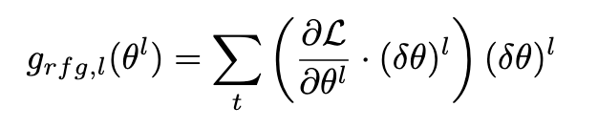
Randomized Forward-Mode Gradient Estimation
By utilizing
efficient forward mode automatic differentiation (AD)
parallel computing ability of neuromorphic hardware
we can estimate the gradient without back-propagation, and thus avoid the expensive surrogate training.
Gradient (by BP)
RFG, global perturbation
RFG, layer-wise perturbation
Wan, R., Zhang, Q., & Karniadakis, G. E. (2024). Randomized forward mode gradient for spiking neural networks in scientific machine learning. arXiv. https://arxiv.org/abs/2411.07057

Slide 17
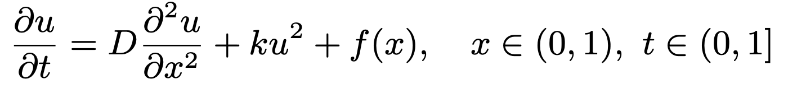
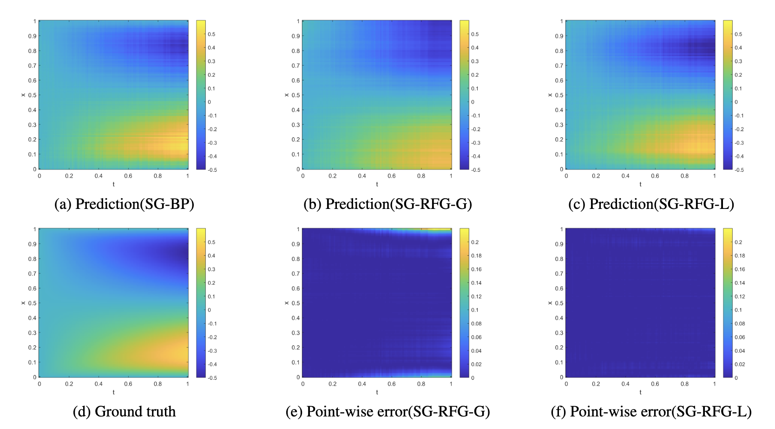
Randomized Forward-Mode Gradient Estimation
We solve the following equation
with zero initial and boundary conditions, where D = 0.01 is the diffusion coefficient and k = 0.01 is the reaction rate.
Scatter plot of the 10,000-dim Sine-Gordon equation solutions. The x-axis represents PINN (ANN) solution and the y-axis represents the converted SNN solution.

Slide 18
Summary
Approach 1: Train with ANN, infer with SNN
High accuracy SNN for SciML can be achieved by ANN-SNN conversion with calibration
Theoretical guarantee and numerical validation
Approach 2: Train with SNN, infer with SNN
Randomized Forward-mode Gradient Estimation for DeepONet
Ongoing work: Weak Gradient Estimation with Stein’s Lemma
Notes:
However, the performance improvement of NN in not a free lunch.

